Slide 1
Electrical Grid System Project
223039847 رغد الغامدي
223034673 قوت الكليب
223005583 وجدان العطية
223011284 رهف الكشي
King Faisal University
Course: Data Structures & Algorithms (0921-211)
Instructor: Dr. Hala Hamdoun

Slide 2
README
# Electrical Grid System - Data Structures Project## Project DescriptionThis project simulates an electrical grid customer management system using core data structures. It allows managing customers and producers using a doubly linked list and a queue for waiting customers. Each customer is linked to a producer using pointers.## Features- Add, Search, Edit, and Delete Customers- Add, Search, Edit, and Delete Producers- Assign customers to producers by ID- Queue system for waiting customers- Serve customers from the waiting queue- Menu-based user interface## Data Structures Used- **Doubly Linked List**: For managing both customers and producers- **Queue (FIFO)**: For handling waiting customers- **Pointer Linking**: Each customer holds a pointer to the assigned producer## How to Compile and Run1. Open the terminal and navigate to the project directory.2. Compile the program using a C++ compiler: ``` g++ -o grid_system main.cpp ```3. Run the program: ``` ./grid_system ```## InstructorDr. Hala Hamdoun## CourseData Structures & Algorithms (0921-211) - King Faisal University

Slide 3
Project Overview
A system that manages electricity customers and producers.
Allows adding, editing, deleting, and searching both entities.
Customers can be assigned to producers.
Unassigned customers are managed using a waiting queue.

Slide 4
Data Structures Used
- Doubly Linked List for Customers and Producers.
- Queue (FIFO) to manage waiting customers.
- Each Customer holds a pointer to the assigned Producer.

Slide 5
System Features
1. Add, Search, Edit, Delete Customers.
2. Add, Search, Edit, Delete Producers.
3. Assign Customers to Producers.
4. Waiting Queue for unassigned customers.
5. Menu-based interface for user interaction.

Slide 6
Code Snippet: Add Customer
Customer* C = new Customer;
Get name, phone, ID, and assigned producer ID.
Search for producer by ID.
If found, assign pointer. Else, leave unassigned.
Insert customer at head of linked list.

Slide 7
Queue Feature
- Customers can be added to a waiting queue.
- They wait until manually served.
- Once served, they are moved to the main customer list.

Slide 8
Project Advantages
✔ Clear use of Linked List and Queue.
✔ Modular and maintainable code.
✔ Covers all operations from course syllabus.
✔ Real-life simulation of grid management.

Slide 9
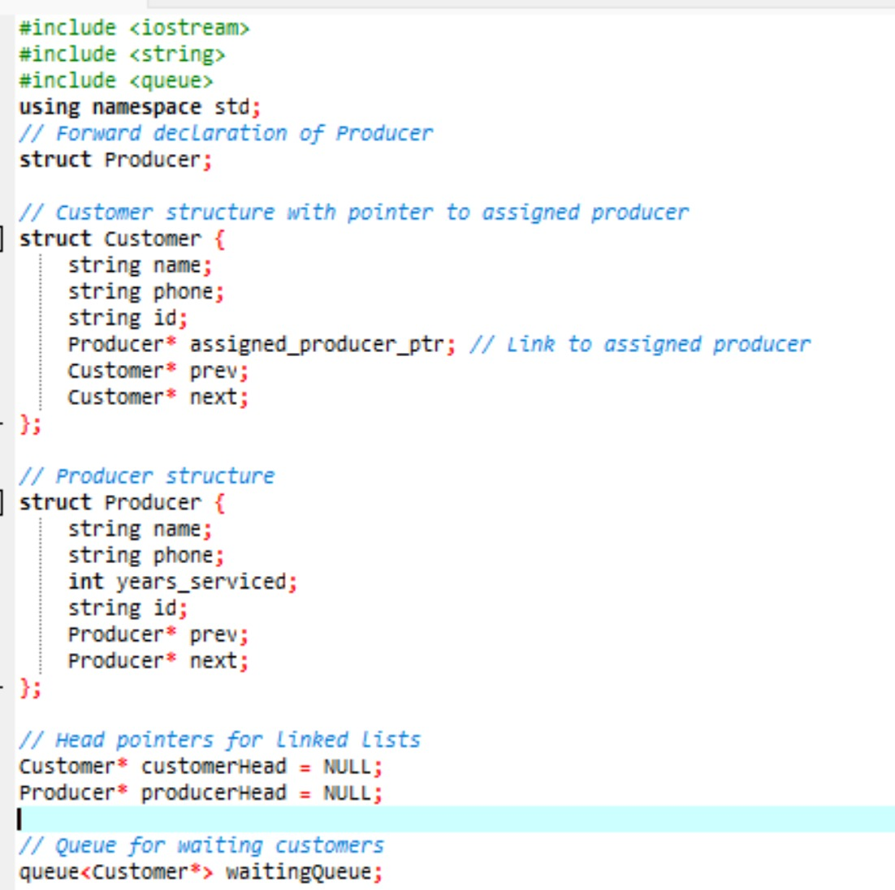
CODE

Slide 10
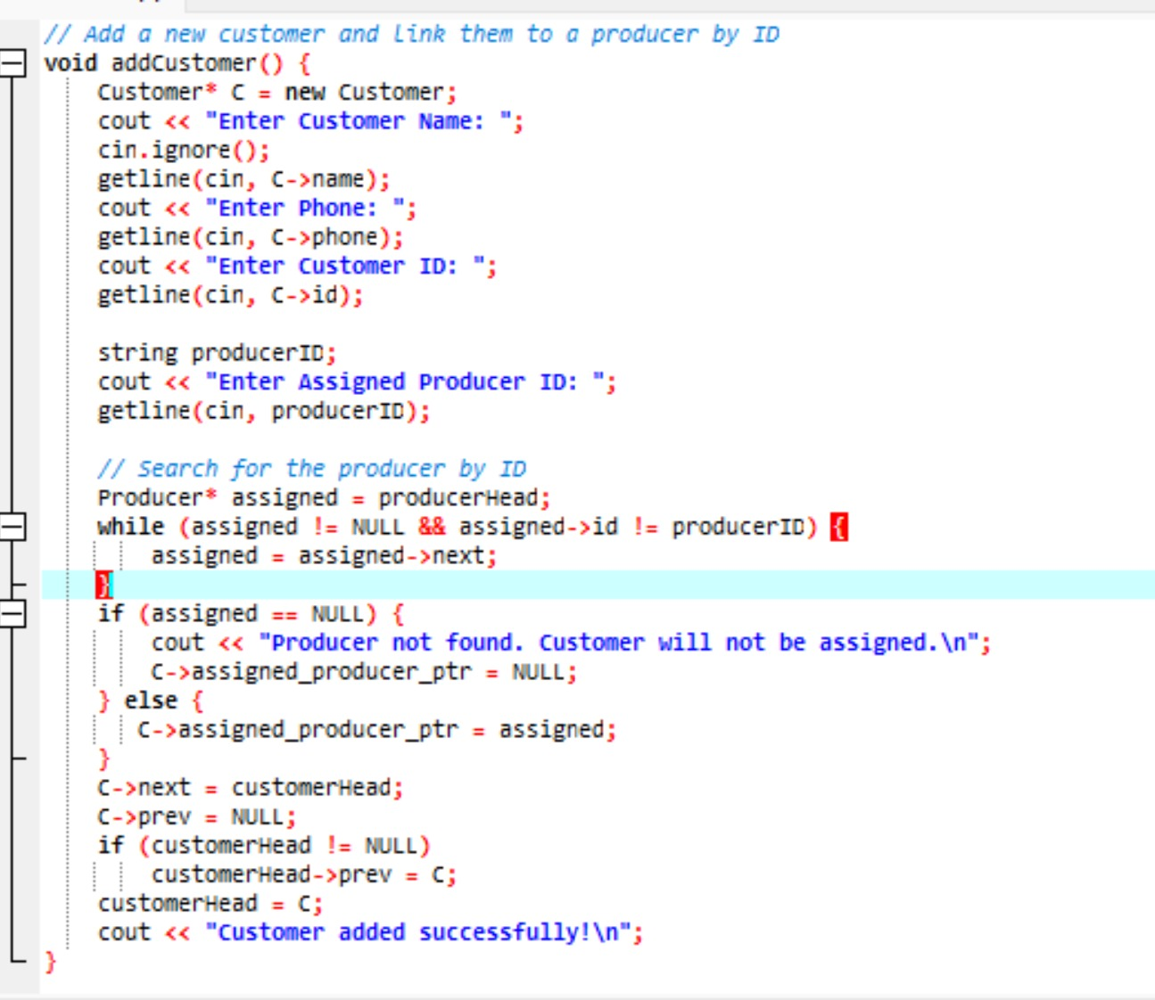
CODE

Slide 11
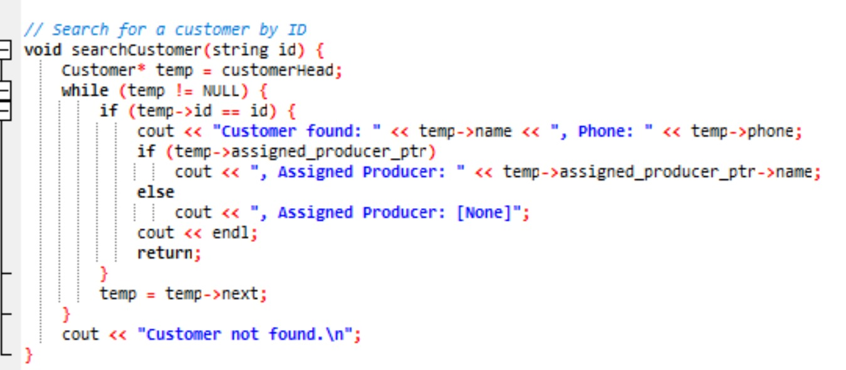
CODE

Slide 12
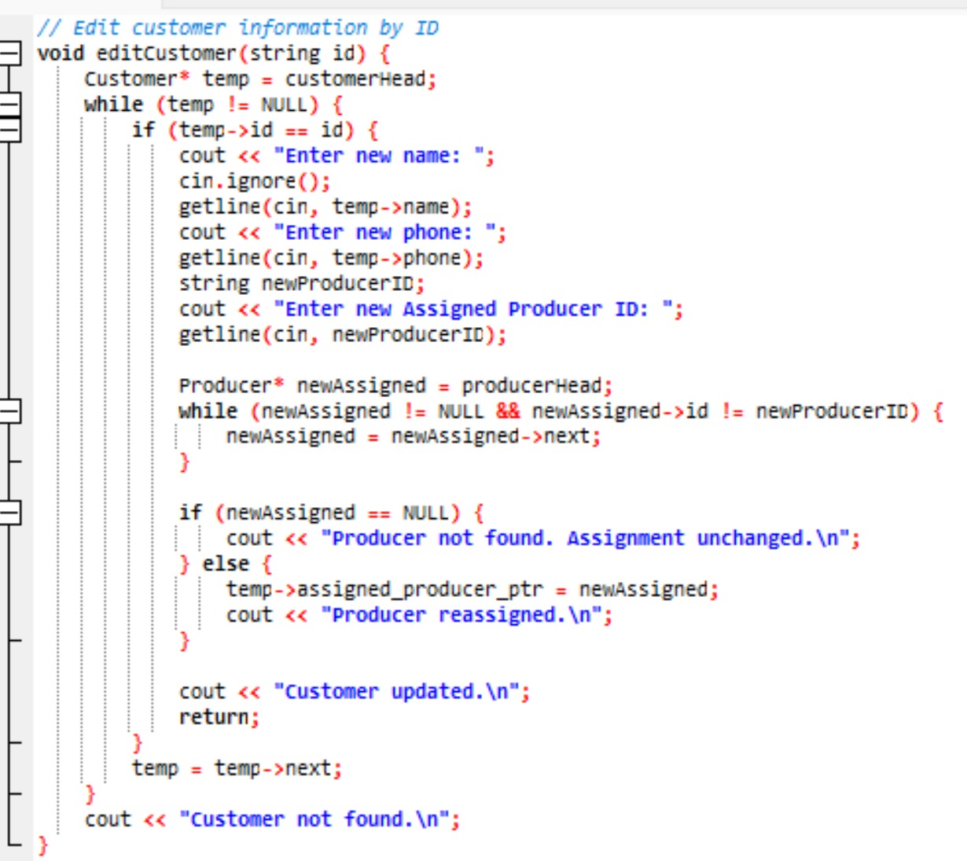
CODE

Slide 13
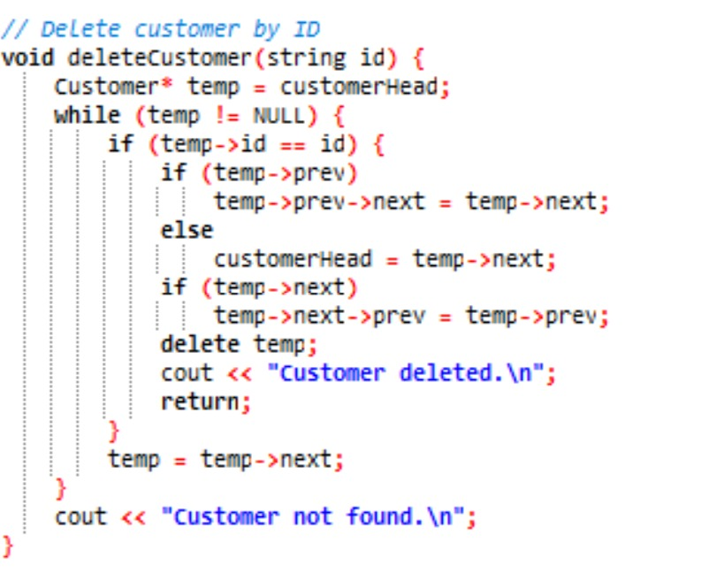
CODE

Slide 14
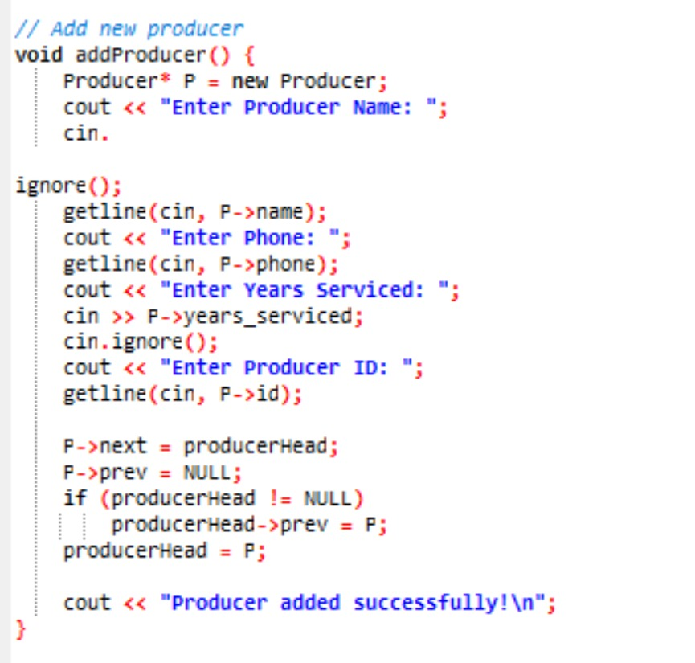
CODE

Slide 15
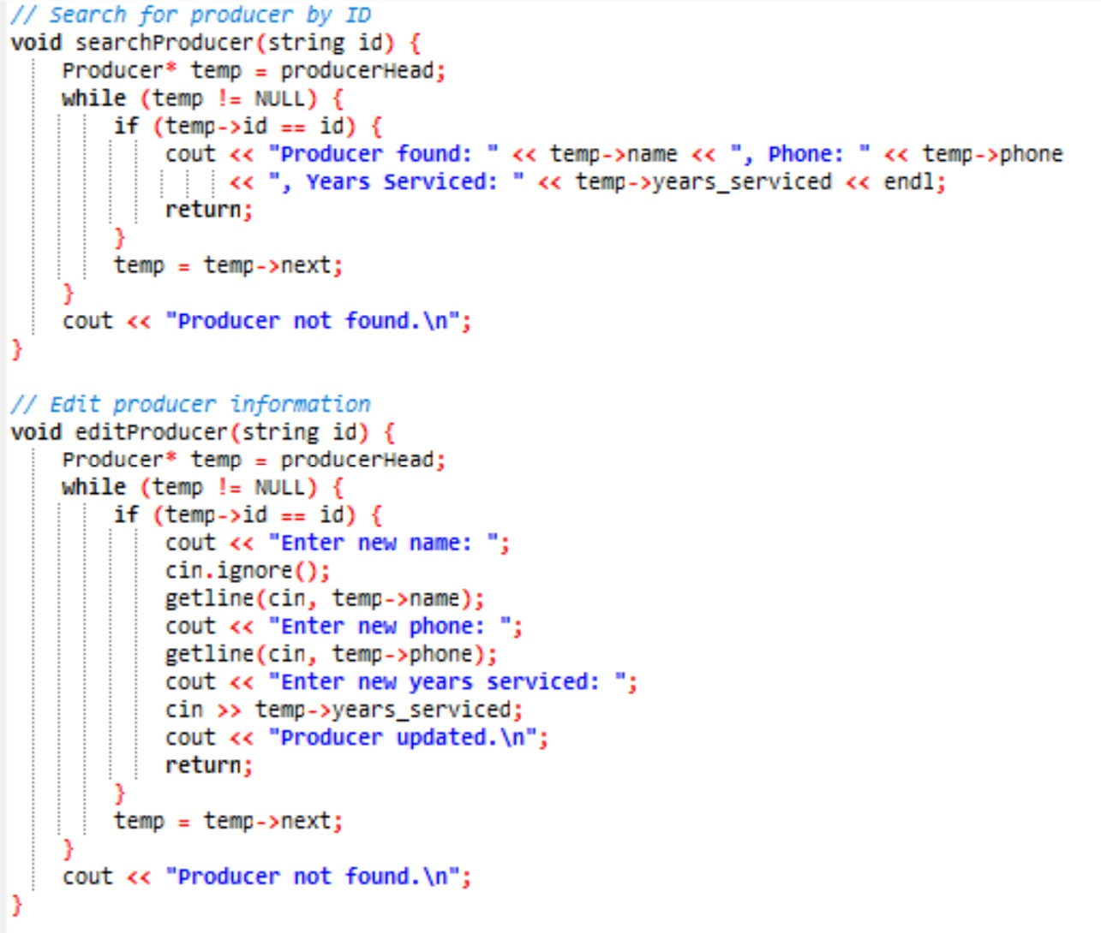
CODE

Slide 16
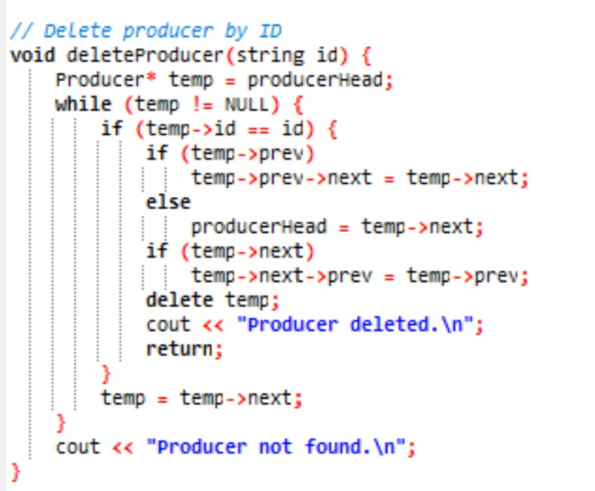
CODE

Slide 17
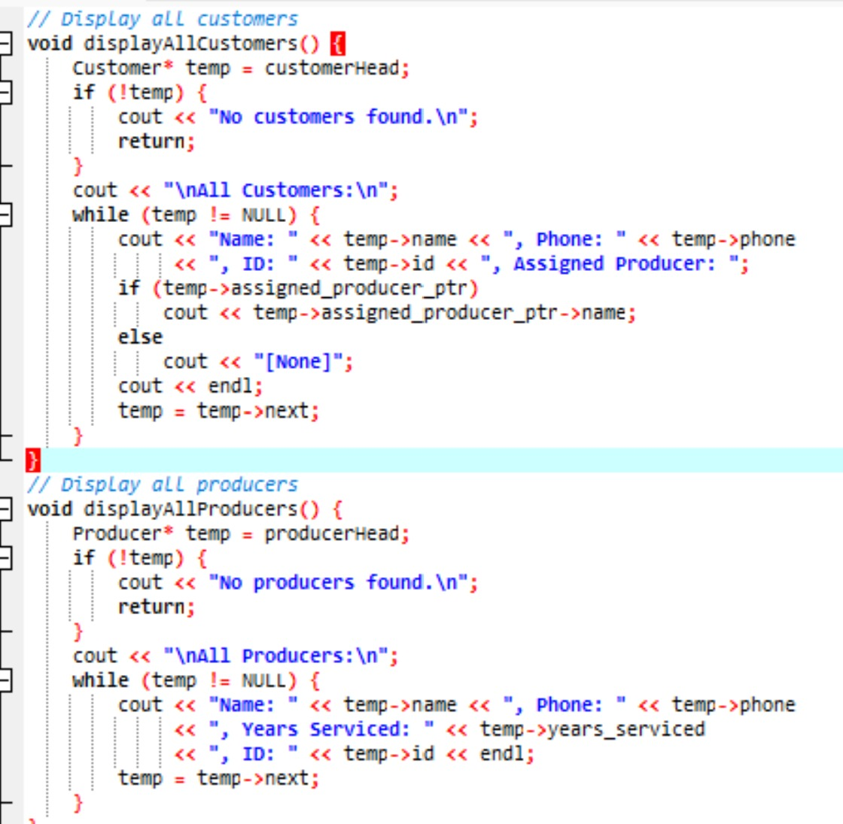
CODE

Slide 18
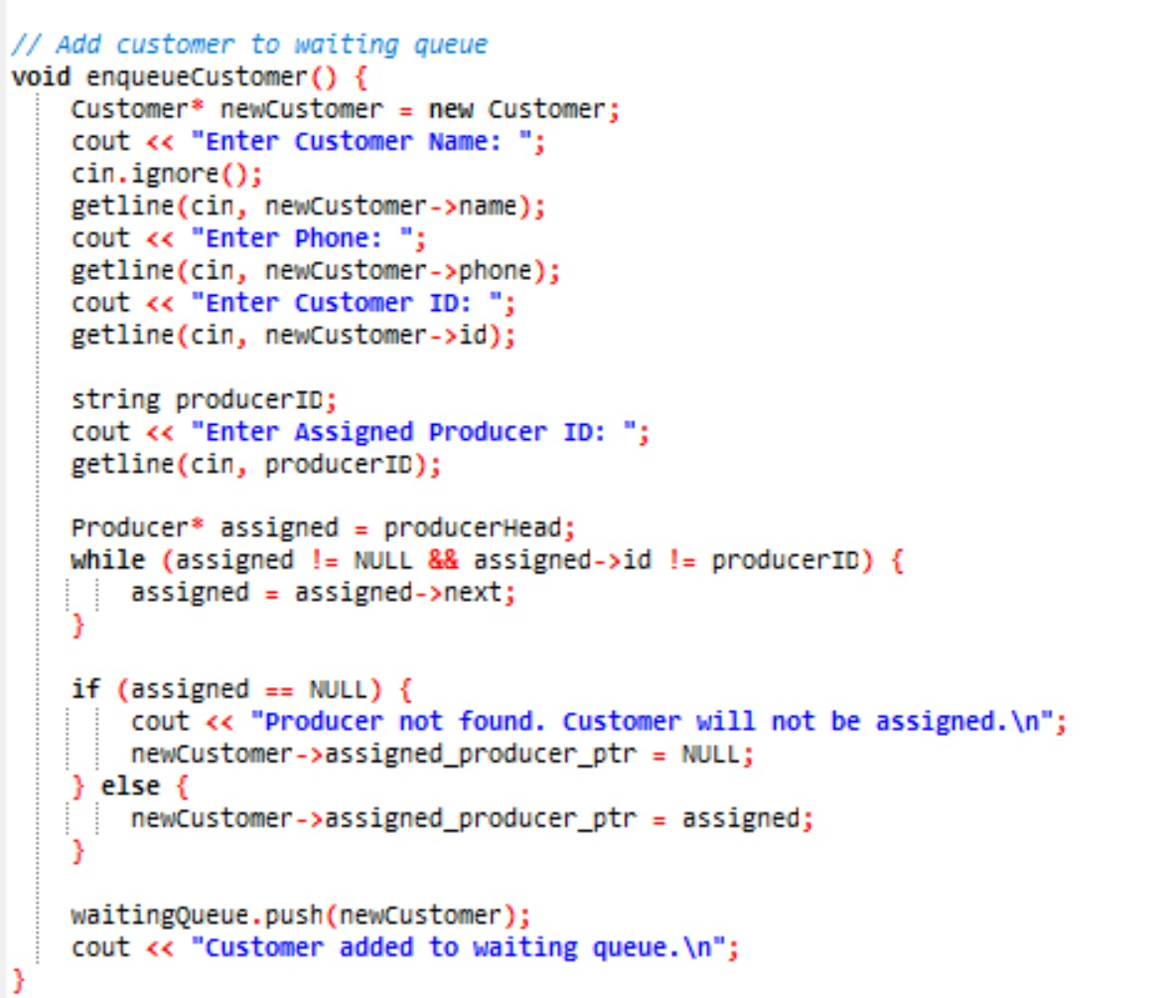
CODE

Slide 19
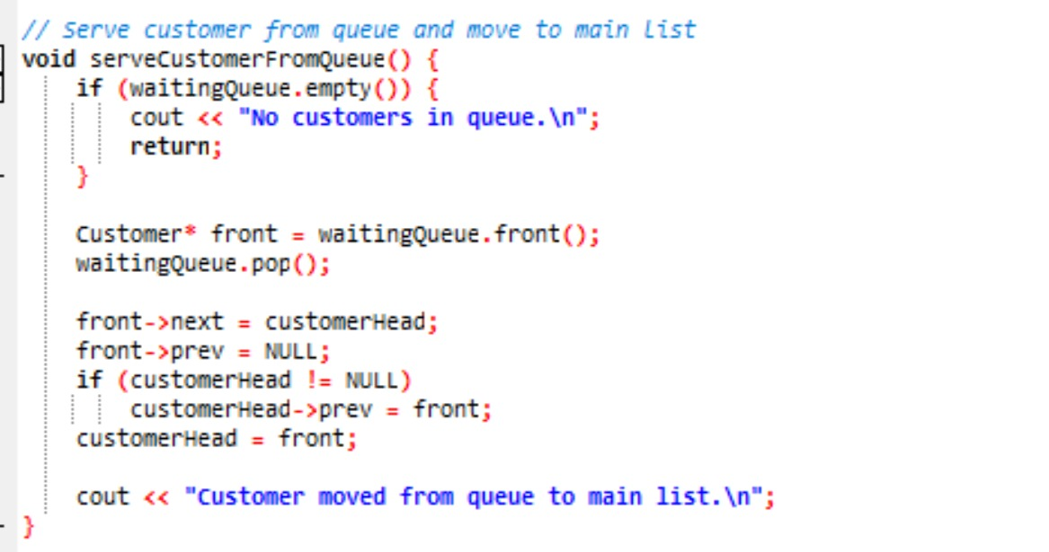
CODE

Slide 20
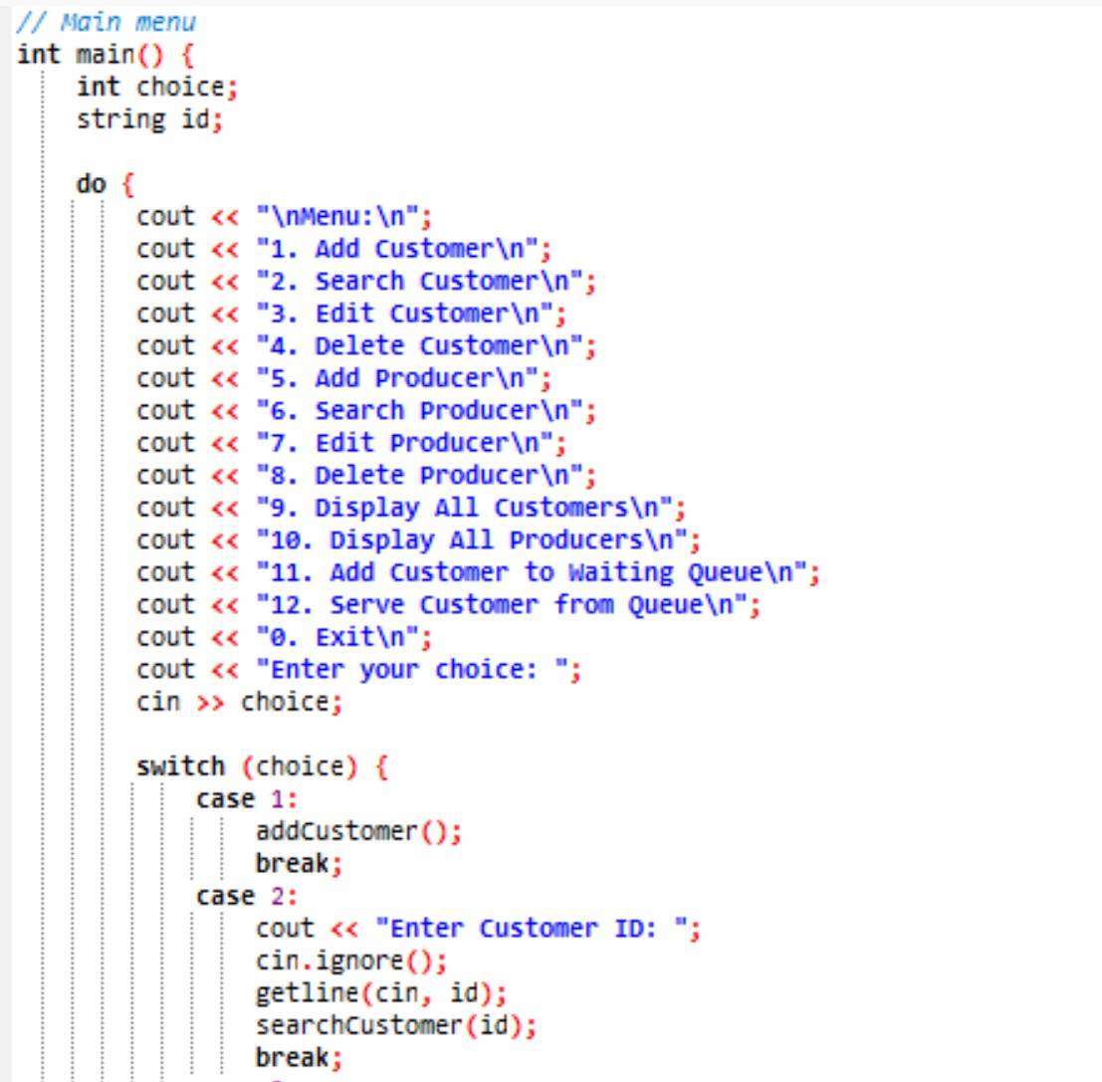
CODE

Slide 21
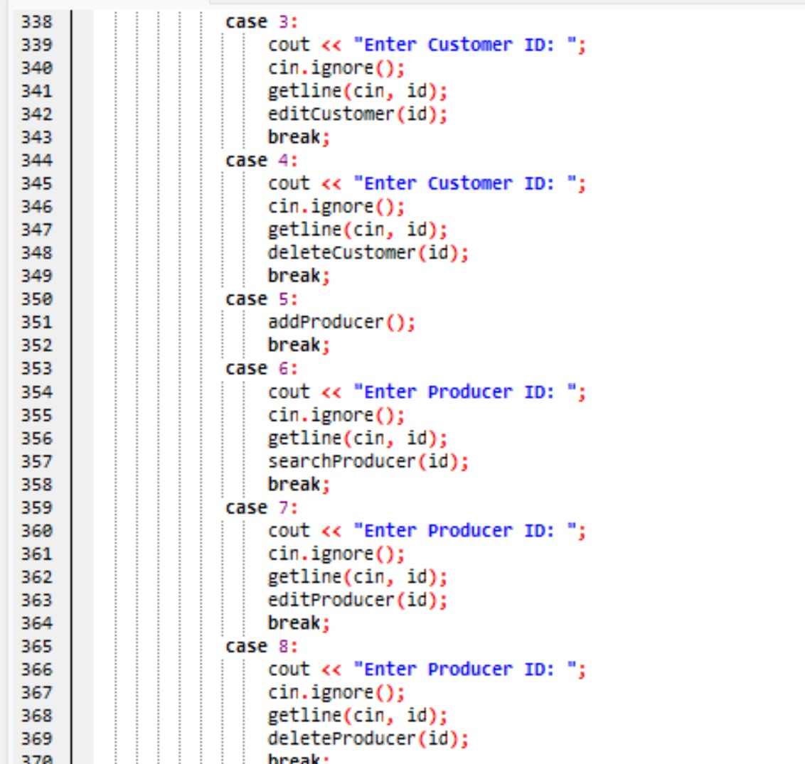
CODE

Slide 22
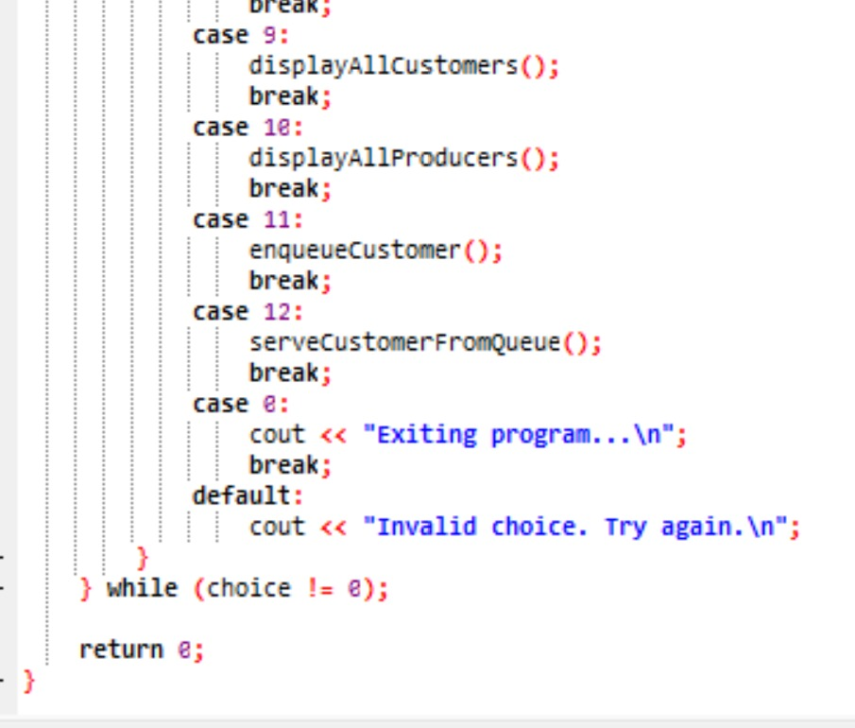
CODE

Slide 23
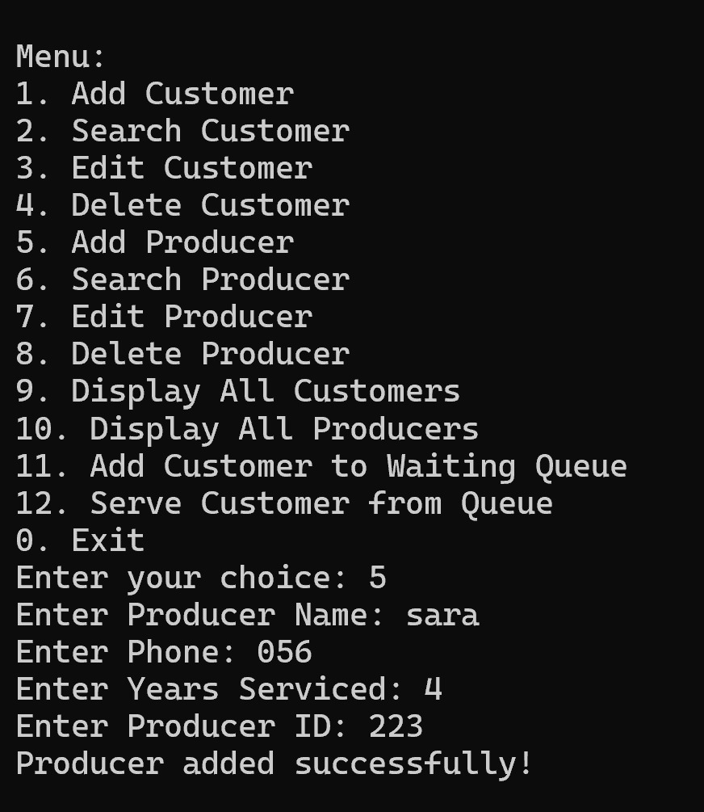
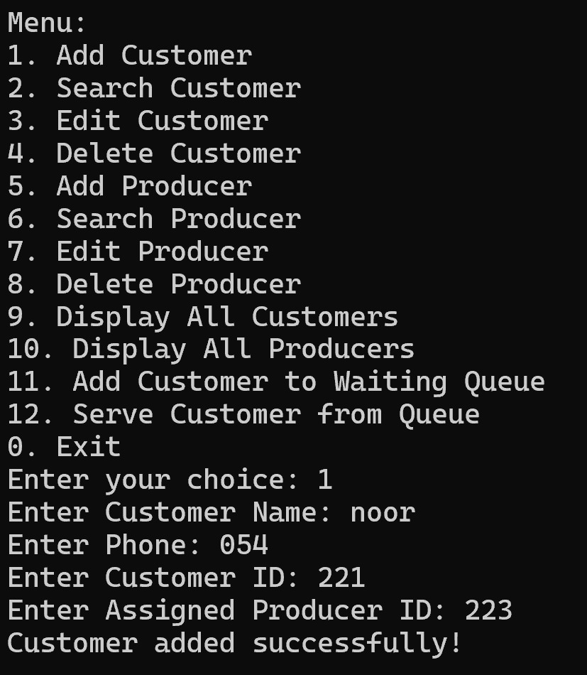
OUTPUT

Slide 24
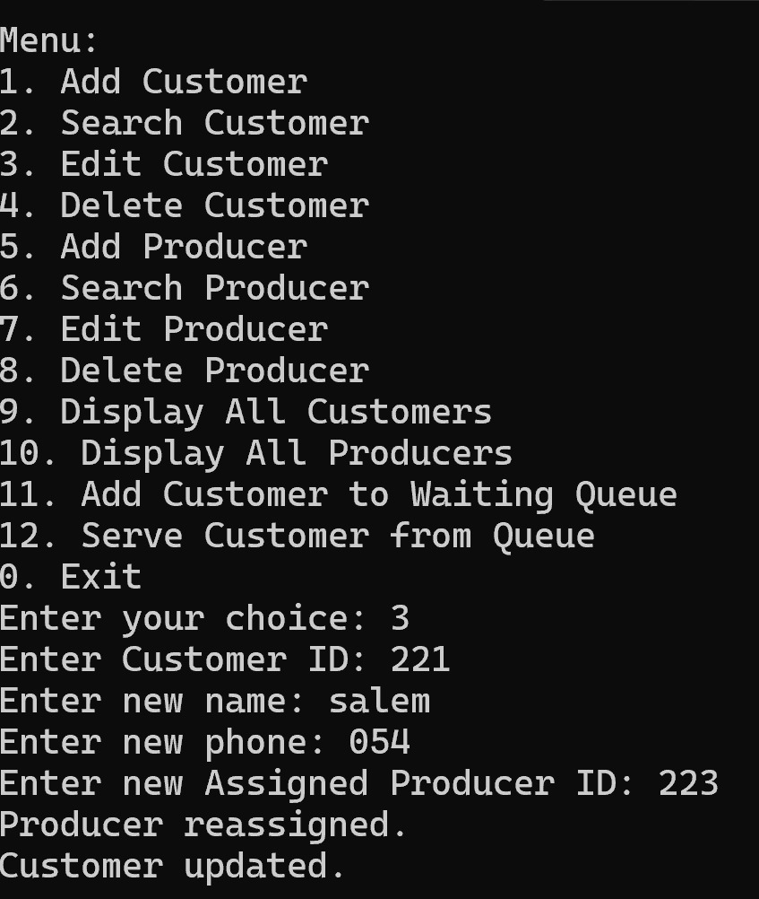
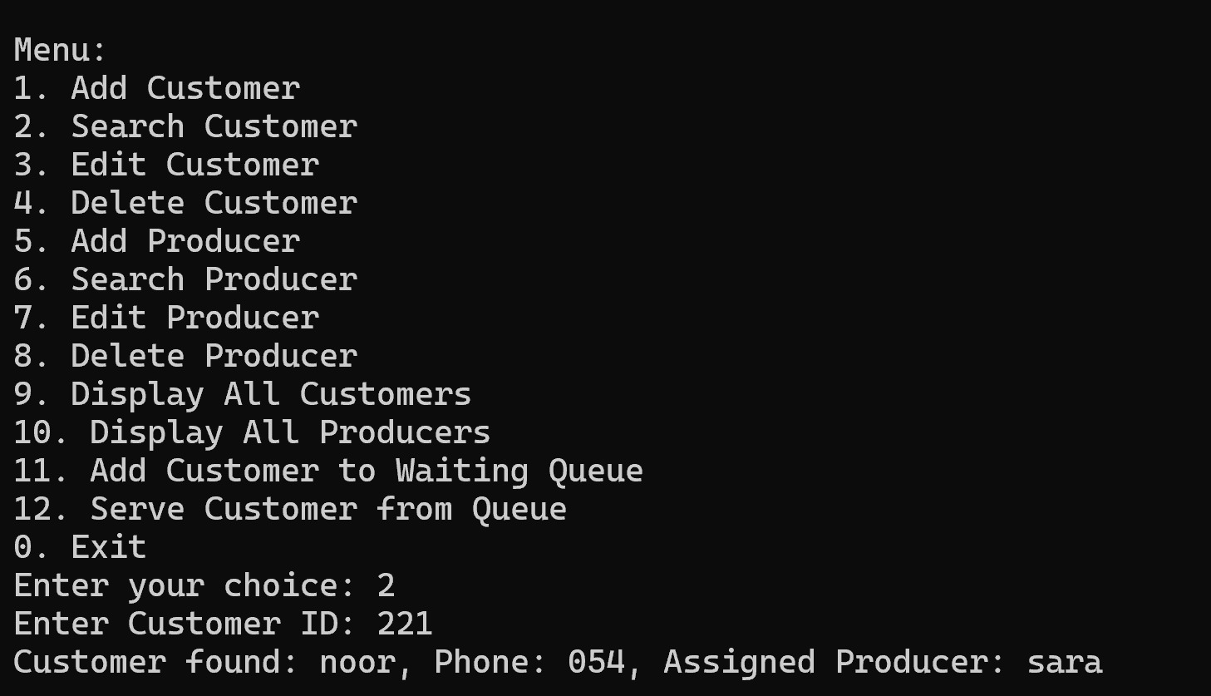
OUTPUT

Slide 25
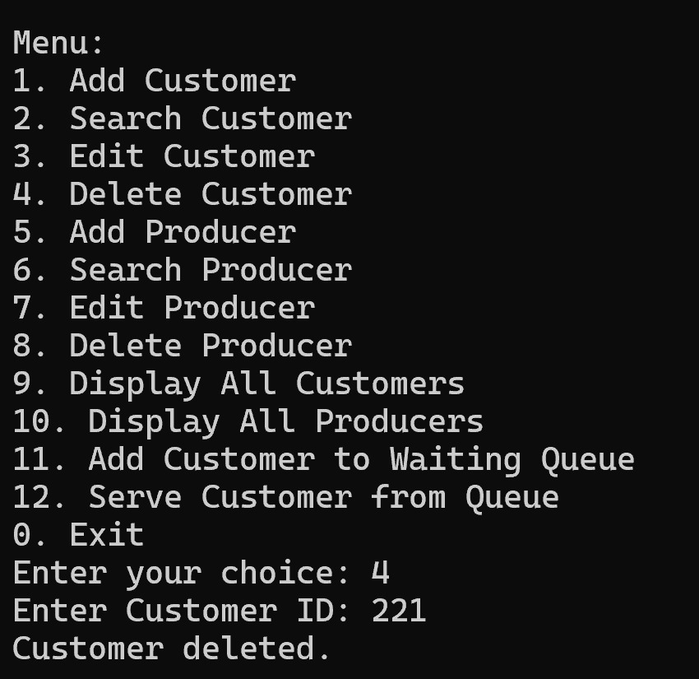
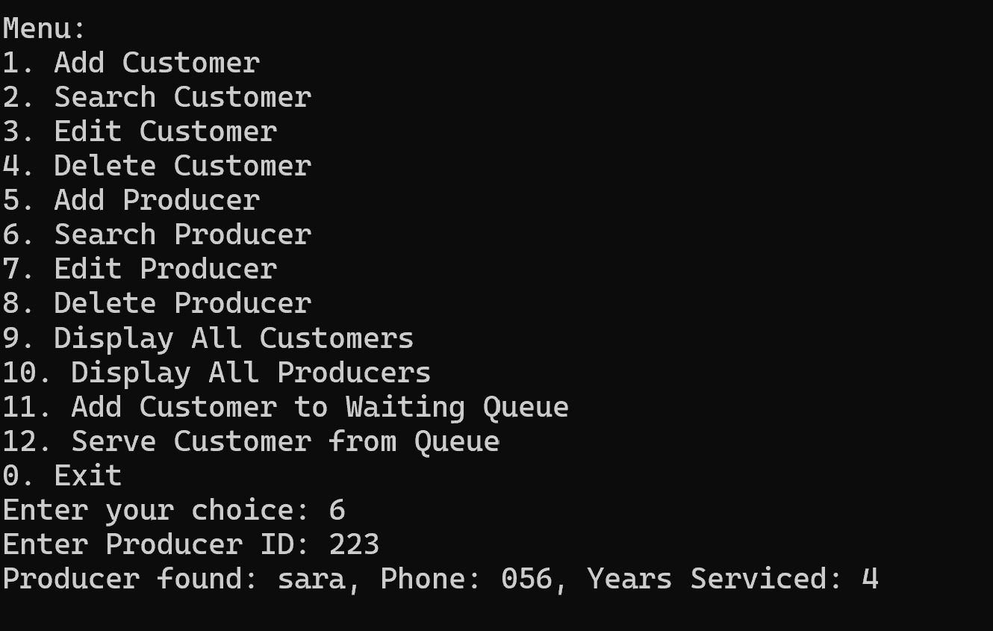
OUTPUT

Slide 26
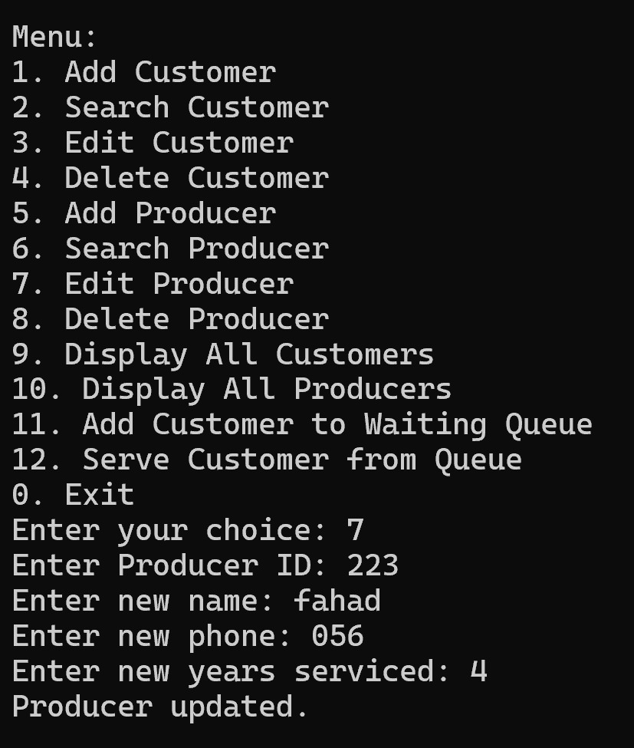
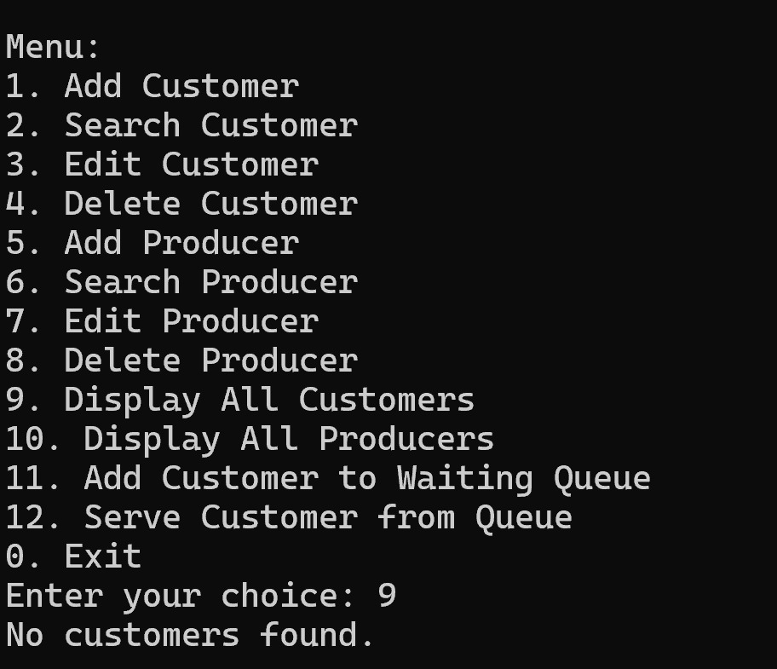
OUTPUT

Slide 27
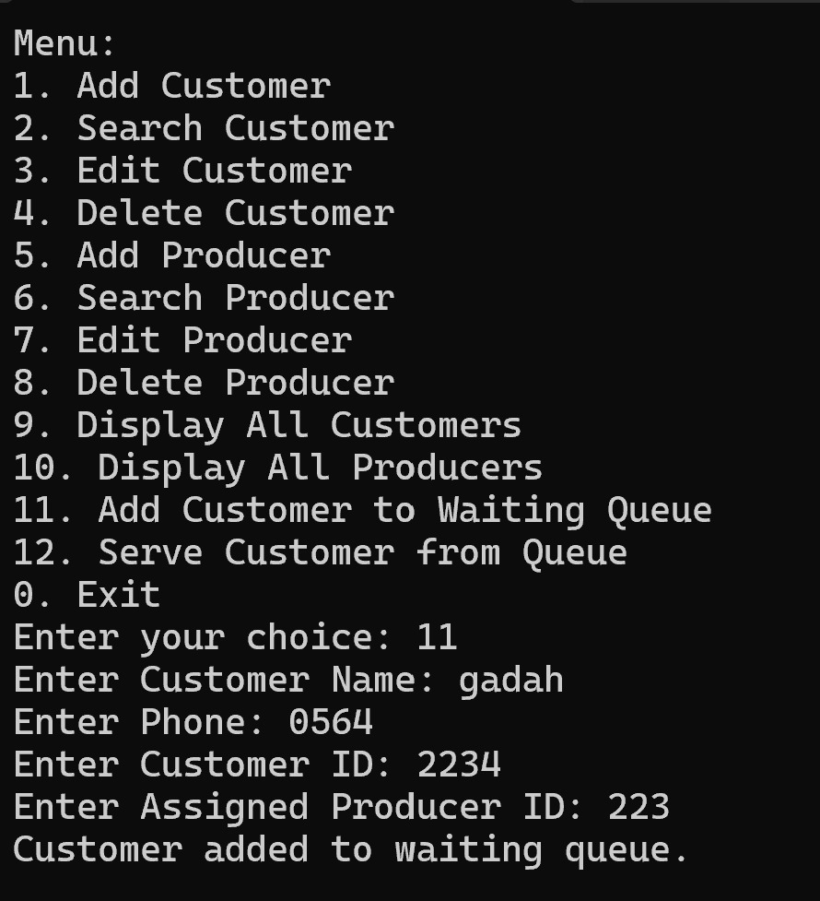
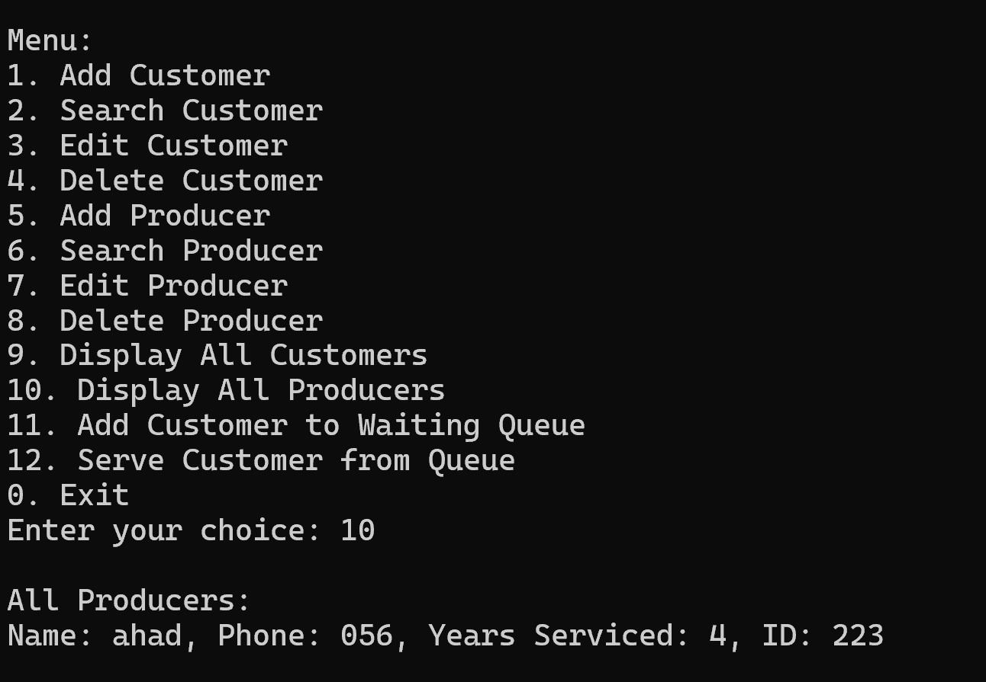
OUTPUT

Slide 28
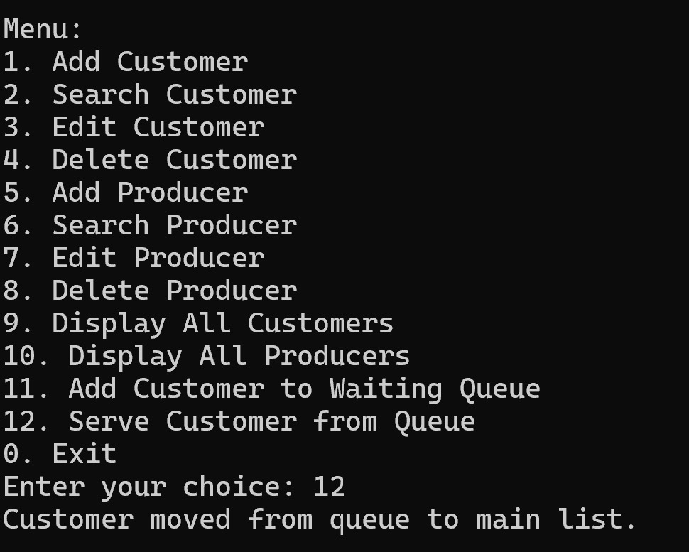
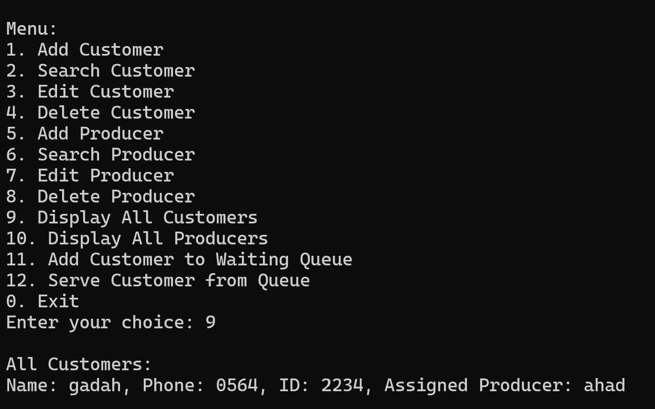
OUTPUT

Slide 29
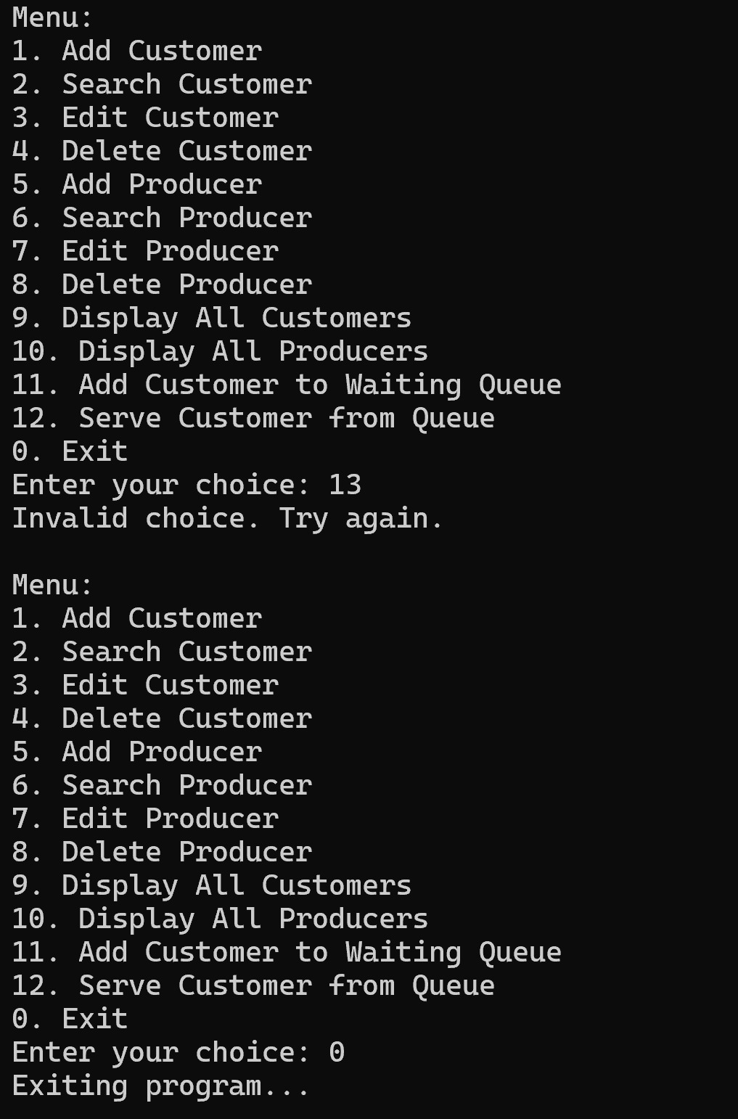
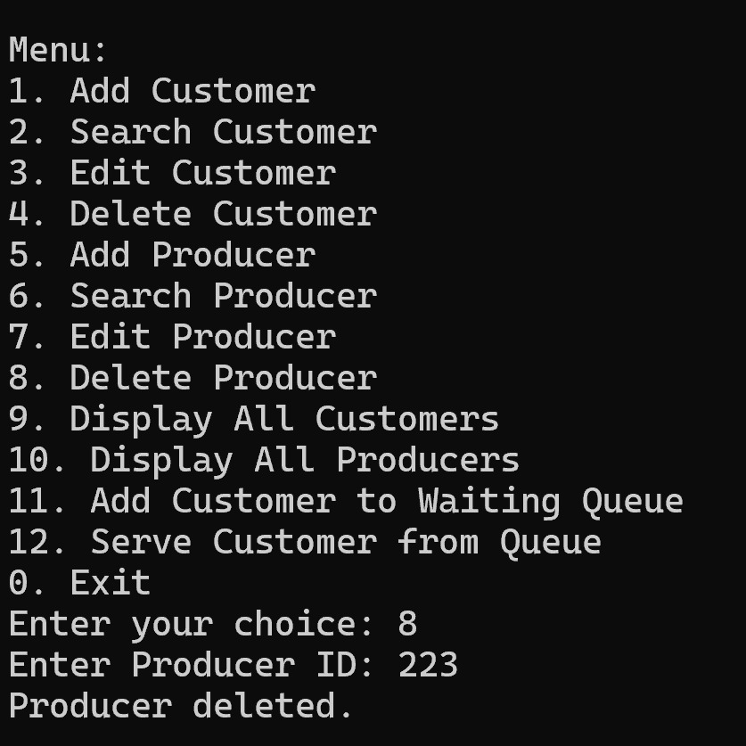
OUTPUT

Slide 30
Conclusion
Project meets all course and instructor requirements.
Implements advanced data structures practically.
Ready for presentation, grading, or future extensions.

